Slide 1
Research Update
Connor Emmons

Slide 2
Contents
Brief Overview of Earth-Moon Cyclers
Current Work Done
Possible Research Routes
Discussion

Slide 3
Brief Overview

Slide 4
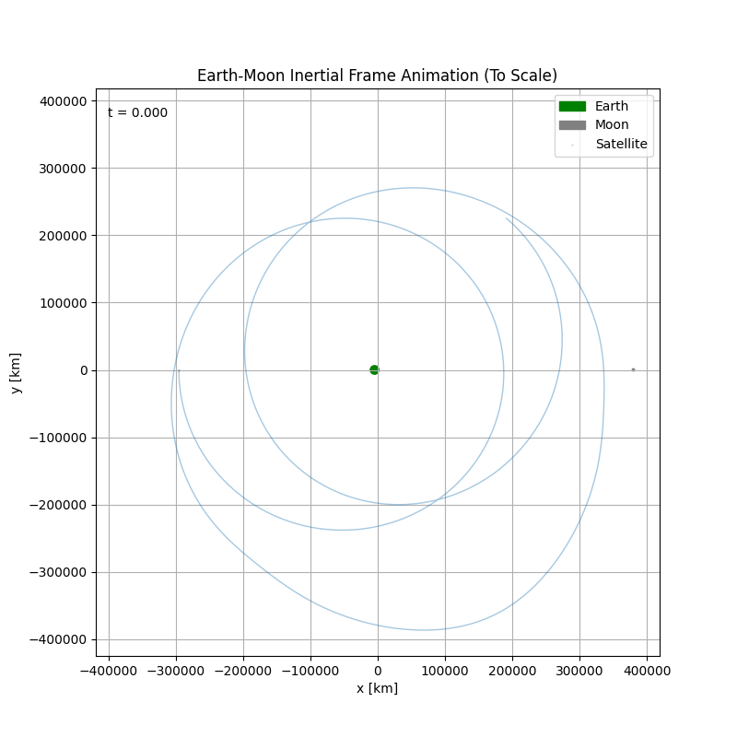
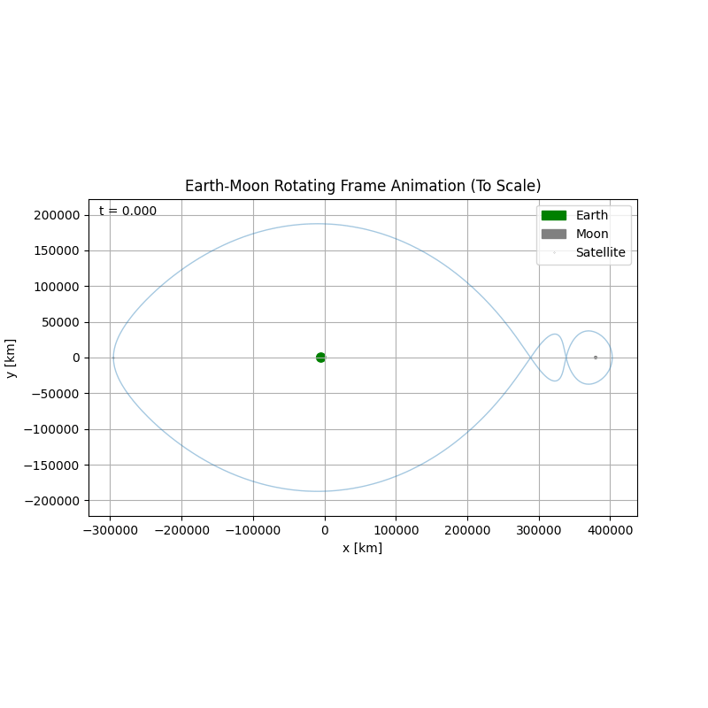
Ballistic Earth-Moon Cyclers

Slide 5
Current Work Done

Slide 6
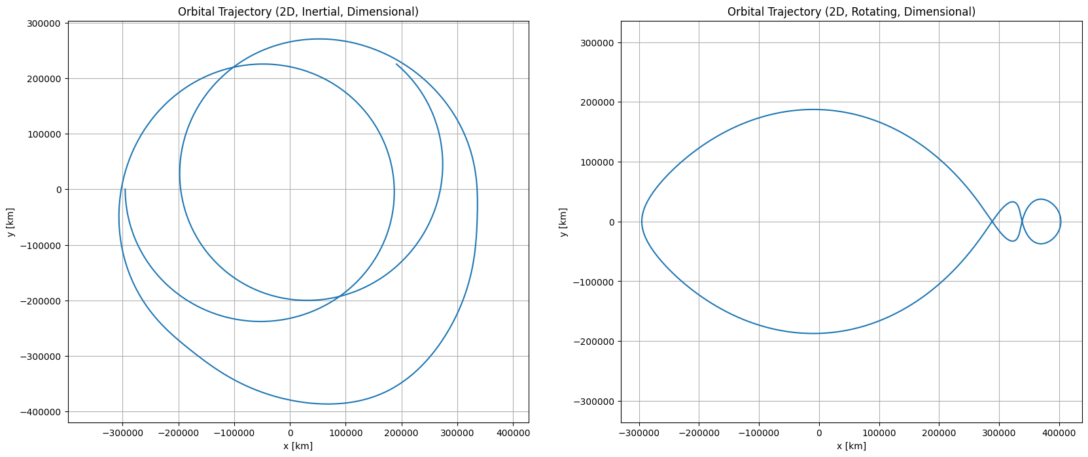
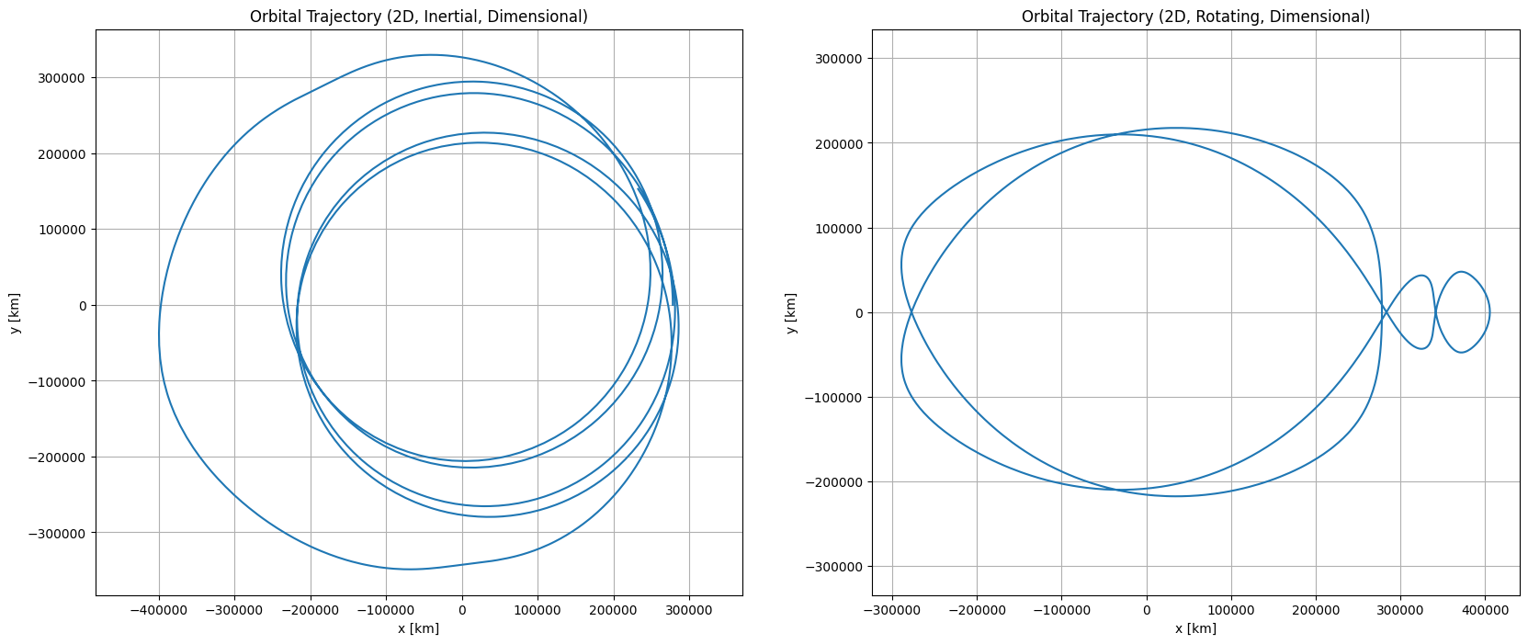
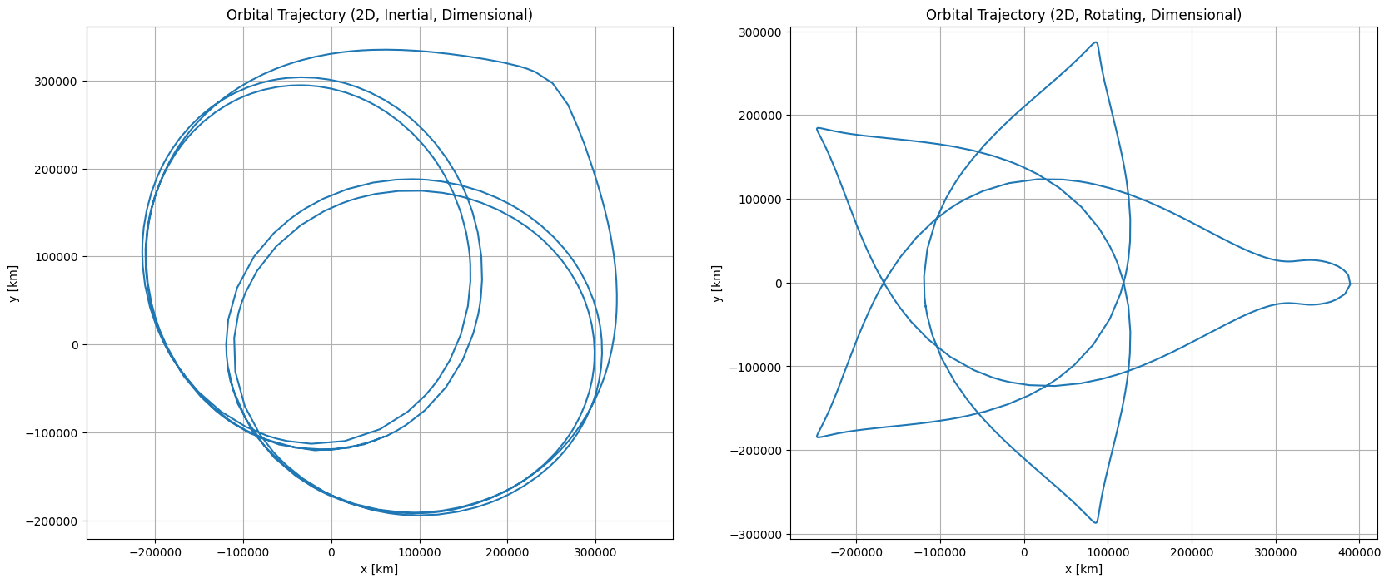
Modeled 1-1, 2-1, 3-1 Cyclers

Slide 7
Non-Planar Cyclers

Slide 8
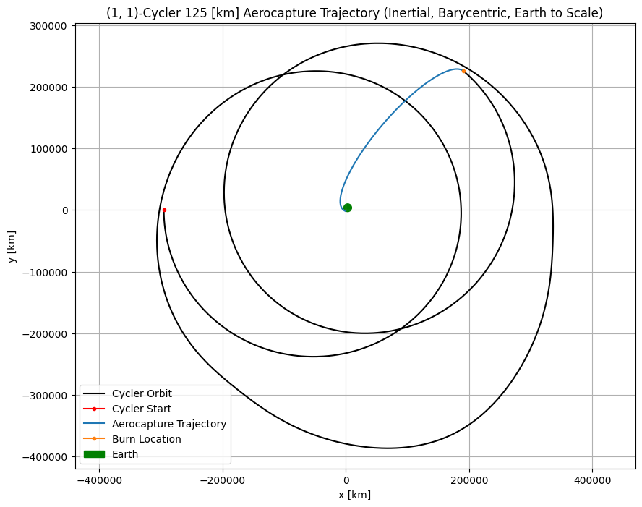
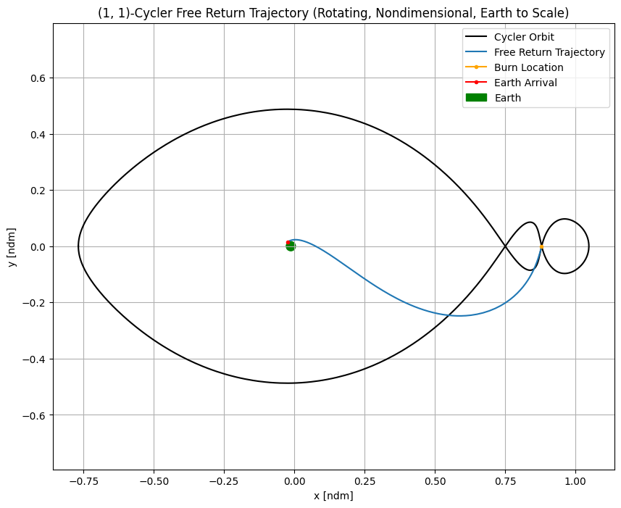
Aerobraking and FRT

Slide 9
Extra Slides

Slide 10
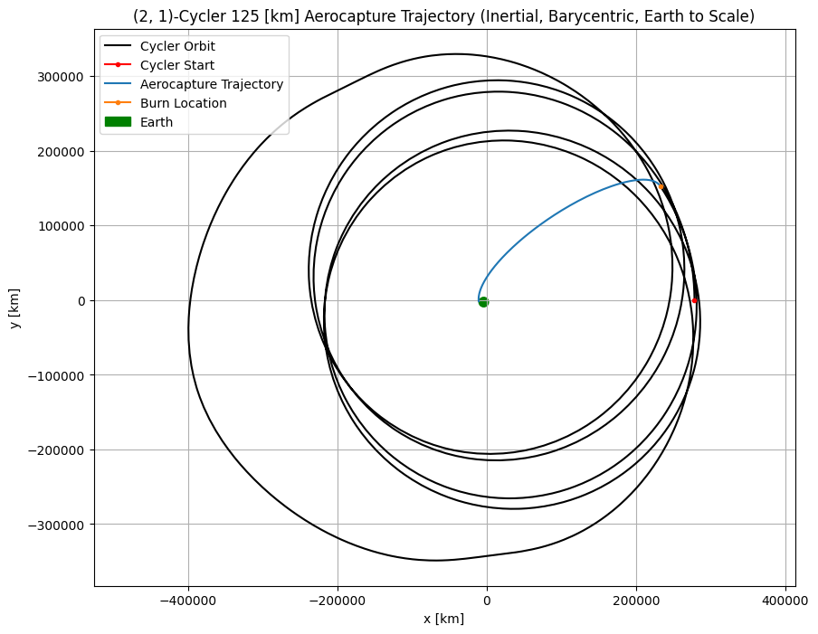
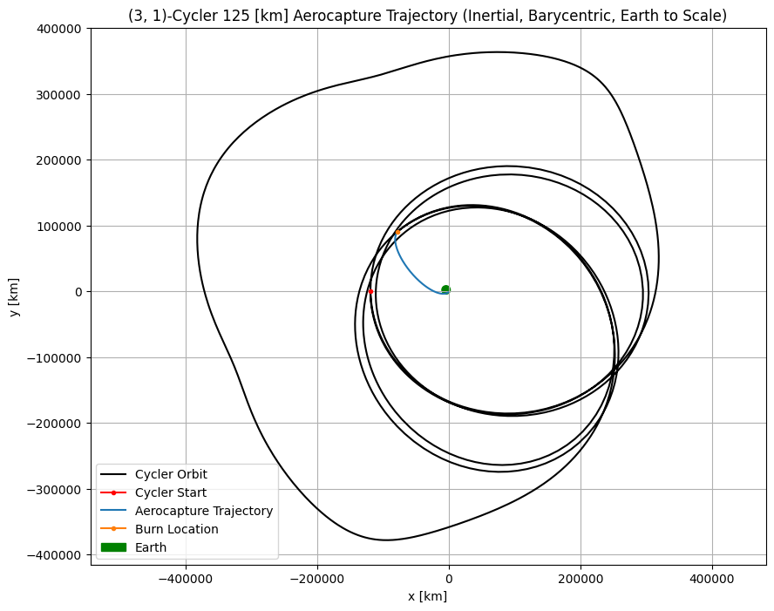
Aerobraking for Other Families

Slide 11
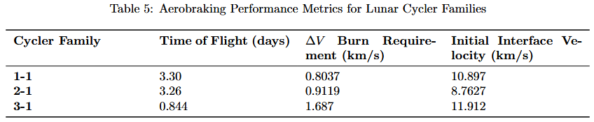
Aerobraking Data

Slide 12
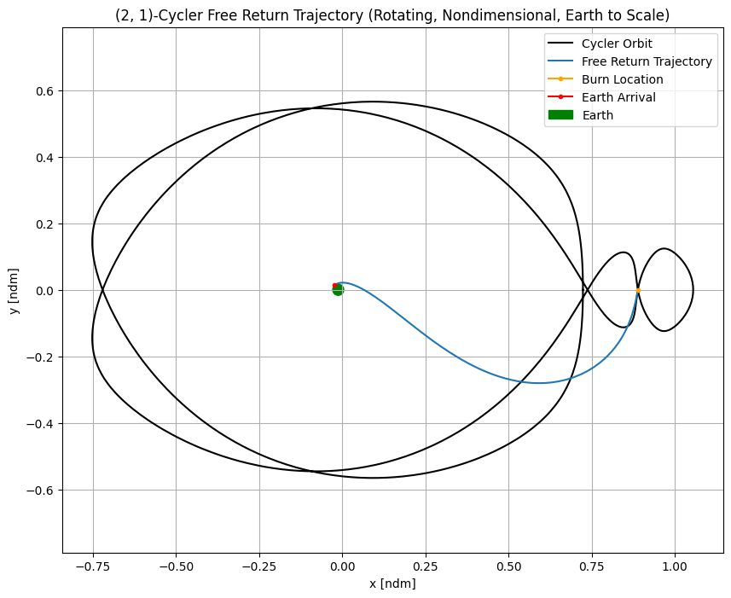
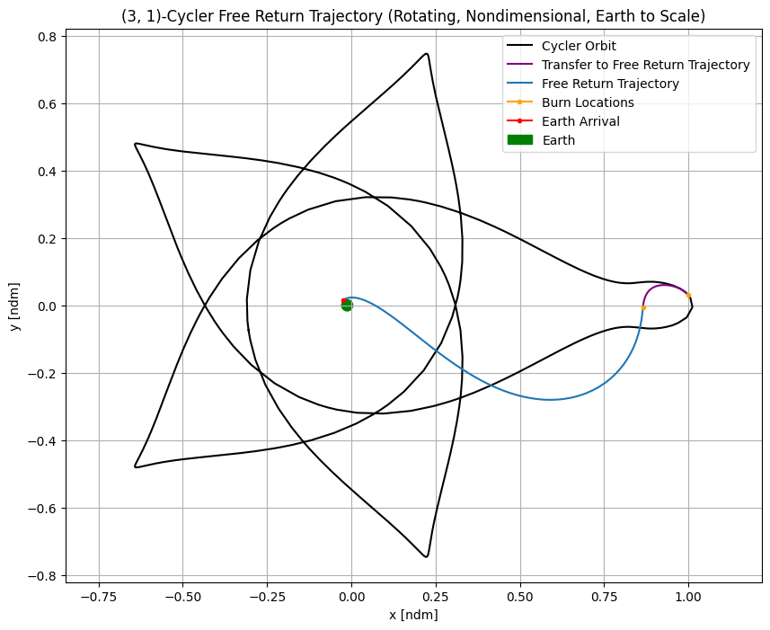
Free Return for Other Families

Slide 13
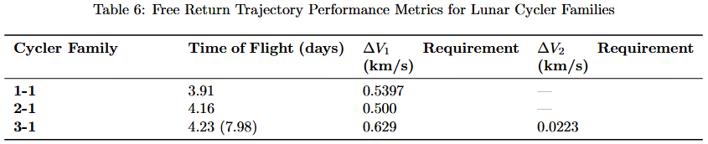
Free Return Data

